Slide 1
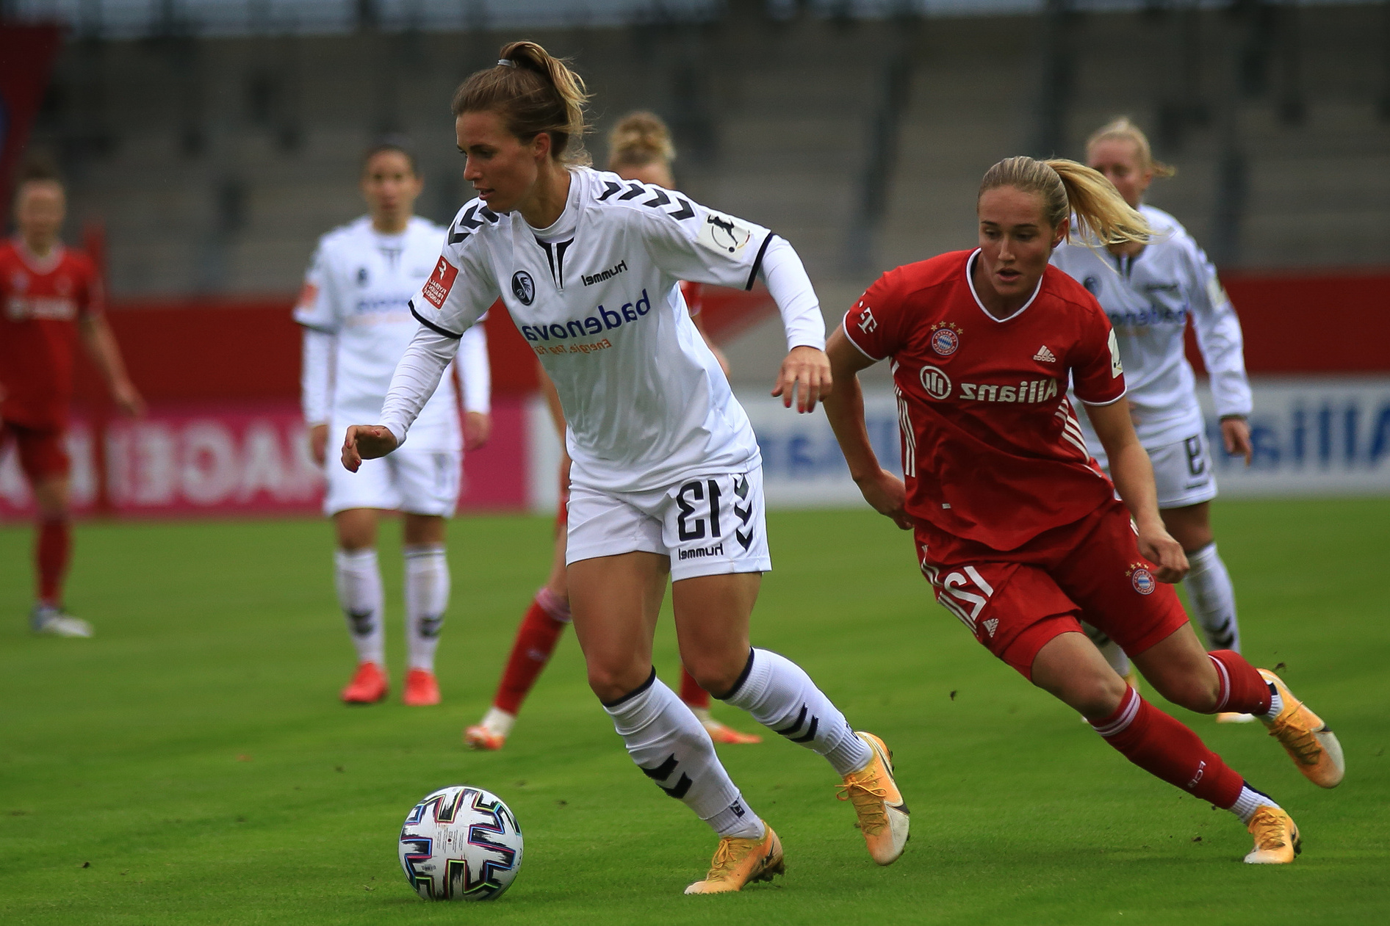



Data Titans
Are Teams with high Team Spirit Likely to Come Out as Champions?
A Data Presentation for the WIDA Datathon 2023

Slide 2
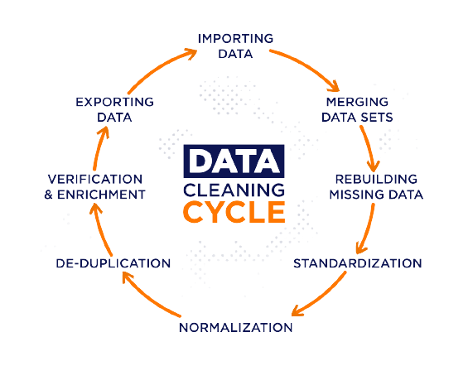
Data Cleaning & Transformation
Removal of null values from the possesion, yellow_cards, red_card columns by replacing them with the median values by teams
Attempt to drop duplicates
Capping of outliers using 75:25 IQR method
Derivation of champions, hosts, host_country, and distance_in_miles columns
Link to clean dataset

Slide 3

EDA GOALS
To understand the relationship between variables
To use the understanding of these relationships to generate hypothesis
To carryout statistical tests to accept or reject both hypothesis:
Null hypothesis 1: goals have no effect on turning teams to champions
Null hypothesis 2: assists have no relationship with goals
Link to the Python Scripts on both cleaning and EDA
EDA STEPS
Univariate
analysis
Bivariate
analysis
Multivariate
analysis
Hypothesis generation & testing

Slide 4
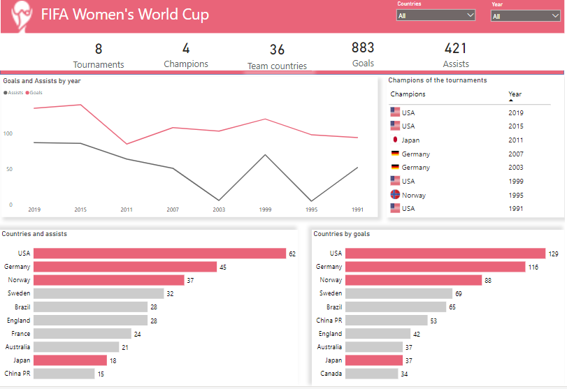
Click the image to be redirected to the live dashboard

Slide 5

Conclusion
Recommendations
Three out of the four champions have the highest total number of goals
For teams to improve their chances of winning, the team coaches should improve teamwork between players by doing the following:
Engage players in drill exercises where they rely on each other to scale through
Measure teamwork by assists to see how well players work together
Place players in strategic positions where one player's strengths complement the weaknesses of the other
Call out specific players after training that exhibited team play
Make every player heard and seen during decision making
There's a relationship between assists and goals seeing that these three top teams still have the highest number of assists is proof

